Slide 1
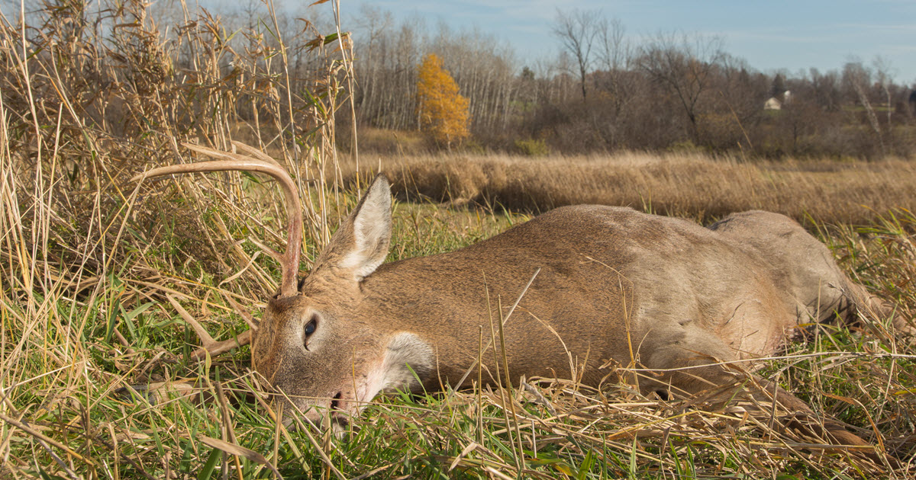
Epizootic Hemorrhagic Disease (EHD) in White-tailed Deer

Slide 2
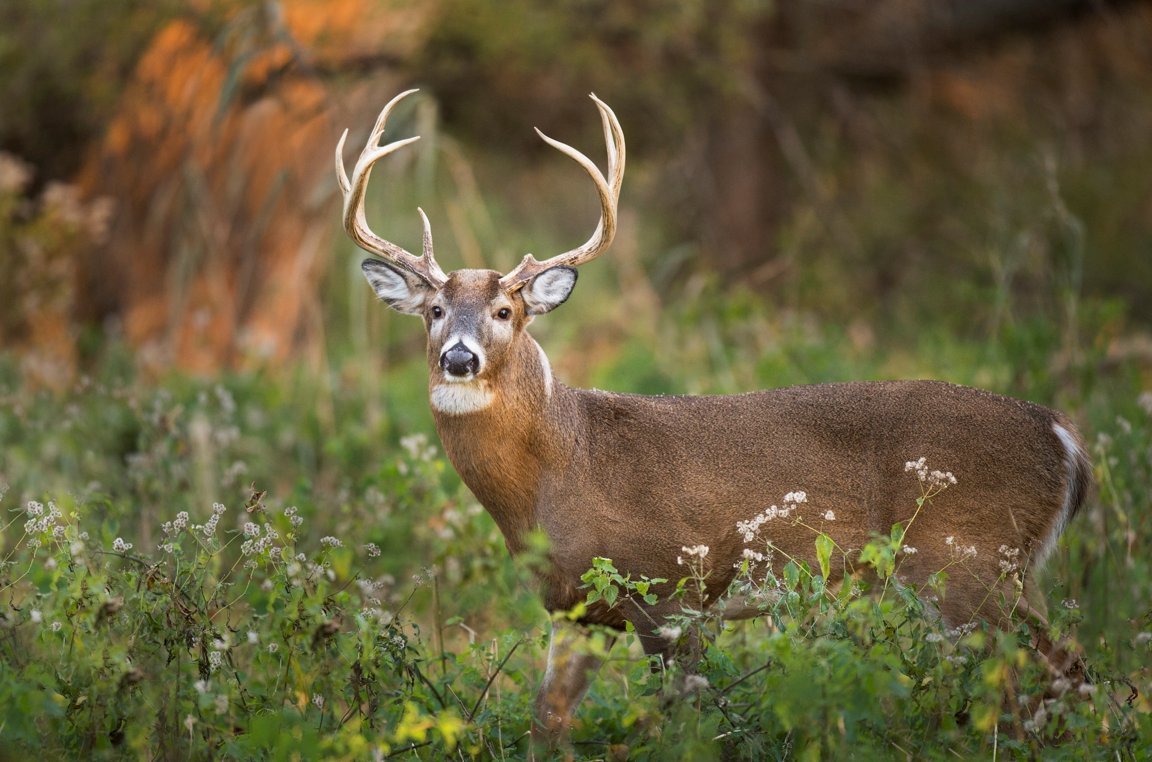
What is EHD?
Epizootic: disease occurs at an unexpected time/place or at a rate substantially greater than expected
Hemorrhagic: causes hemorrhaging (bleeding from ruptured vessel)
Primarily affects White-tailed deer
EHDV related to Blue Tongue Virus
Hemorrhagic Disease
Notes:
EHD is an untreatable, vector-borne hemorrhagic disease that causes hemorrhaging, hoof-sloughing, fever, swelling, ulcers, erosions, lameness, and death. Its name is a misnomer derived from its association with unexpected mass die-off events in the 50’s, but later research showed it is an enzootic disease in the South occurring yearly. Disease cycle itself may have changed or we just got better at detecting it.

Slide 3
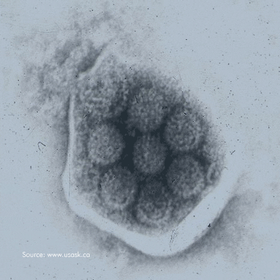
History of EHD Research and Occurrence in White-tailed Deer
EHDV-1 first isolated in white-tailed deer in New Jersey in 1955
Historical data suggests it may have caused mass die-offs in the 1890’s and 1900’s
Mortality events characteristic of EHD have occurred consistently in the USA since 1955
At least seven serotypes of EHDV recognized, but only EHDV1 and EHDV2 have historically circulated in USA. EHDV6 was isolated from dead deer in 2006.
Complete genome sequence of EHDV1, EDHV2, and EHDV6 determined
Research techniques:
Virus isolation and PCR in lab, outbreak investigations, serum sampling, and questionnaires
Notes:
Mass die off events of white-tailed deer in the 1950’s and 1960’s led to significant interest in EHD research. Historical data of mass die-offs of white-tailed deer following seasonal patterns characteristic of EHD have been documented as early as the 1890’s and 1901.
*A study in 2002 found that surviving an EHDV2 infection protected deer from severe clinical disease from EHDV1

Slide 4
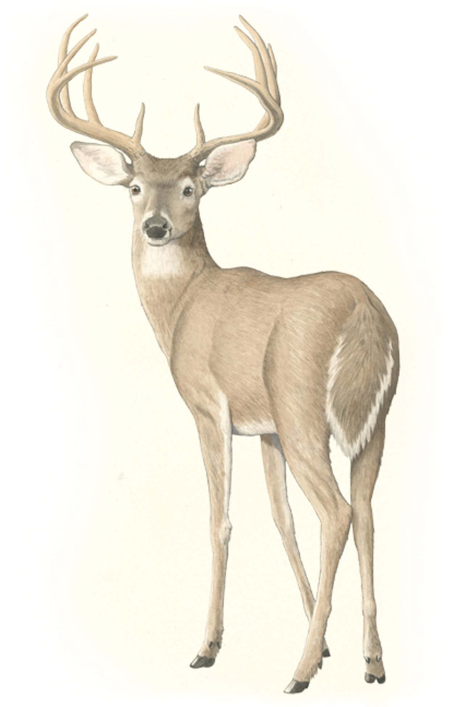
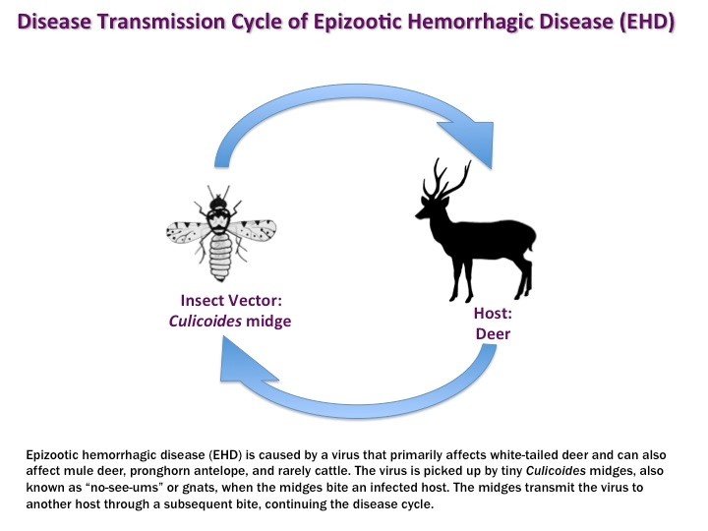
Is EHD contagious or just infectious?

Slide 5
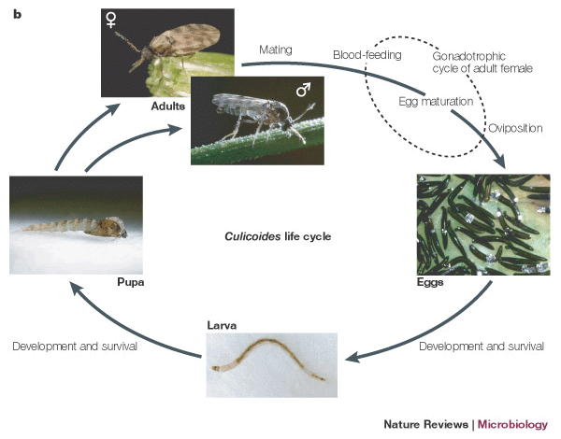
Vector: Biting Midges
(Culicoides spp.)
Midges becomes active at 10.9°C and emerge when above -0.3°C for 7+ days
Midges can carry Orbivirus
Eggs laid in wet environment
Semi-aquatic larval stage in mud
Notes:
EHD is transmitted via hematophagic midges (no-see-em’s) that pick up the EHD virus by drinking the blood of infected individuals. Blood is needed for egg maturation. Midges require warm, wet environments. Eggs are laid in water, mud, or another saturated environment and the semi-aquatic larval stage occurs under the mud or another moist environment like swamps, marshes, and stream shores. When droughts occur and expose the mud or when the environment first becomes 10.9C and then sustains temperatures above -0.3C for a week, the adult midges emerge. Cycle can occur in two to six weeks or longer depending on environment.
Peak incidence occurs with peak vector population (late summer and fall)
Viremia: no more than 3 weeks following infection and occurs in the endothelial cells of the lymphatics and replicates in the lymph nodes and spleen.,

Slide 6
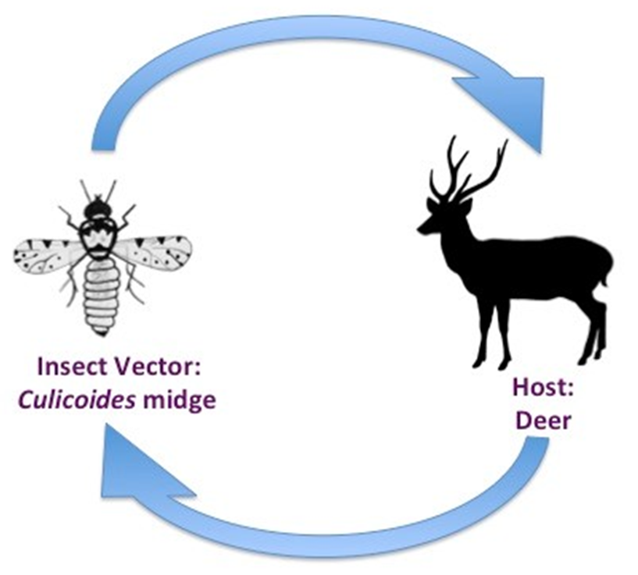
Host: White-tailed Deer
Peracute: Rapid onset and death
Acute: “Classic” symptoms, high fatality rate
Chronic: Mild
Common Symptoms:
Fever
Edema
Lethargy
Lesions
Hemorrhaging
Congestion

Slide 7
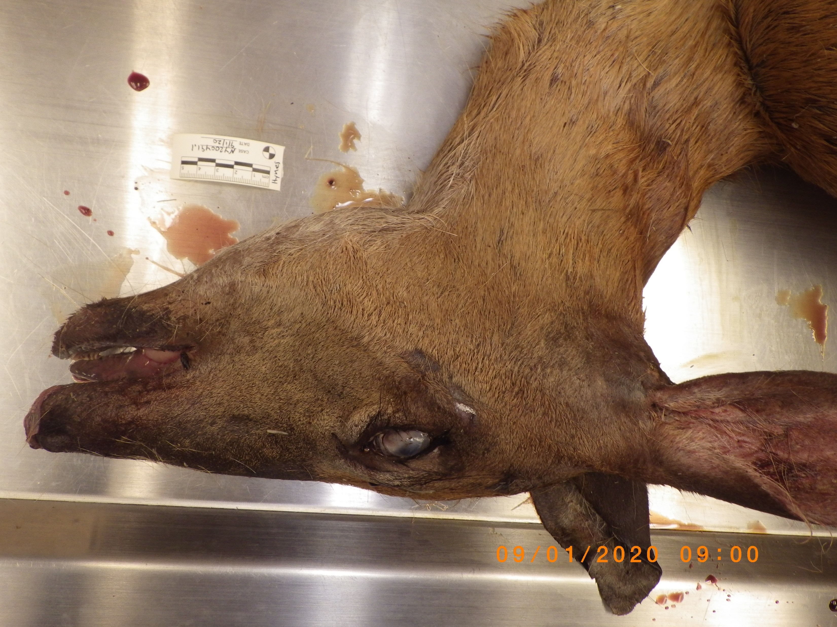
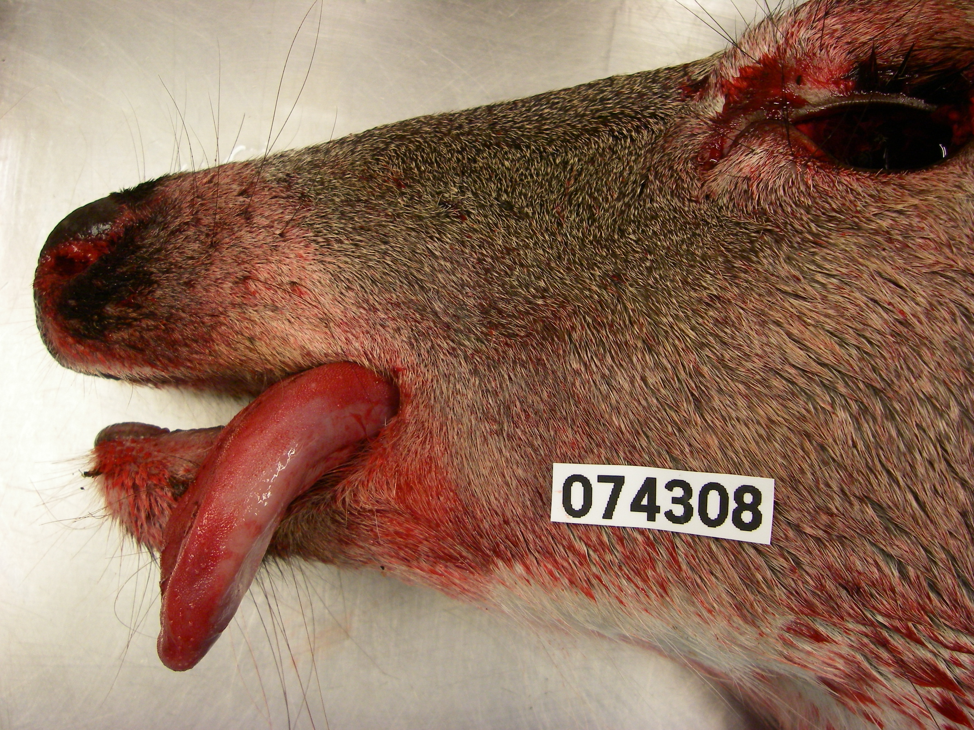
Peracute
Death often occurs within 36 hours of infection
May not exhibit clinical signs
If present, signs include:
Edema of head and neck
Swelling of the tongue
Fever
Weakness
Anorexia
Respiratory distress and congestion
Lesions
Notes:
Dead found near water from fever

Slide 8
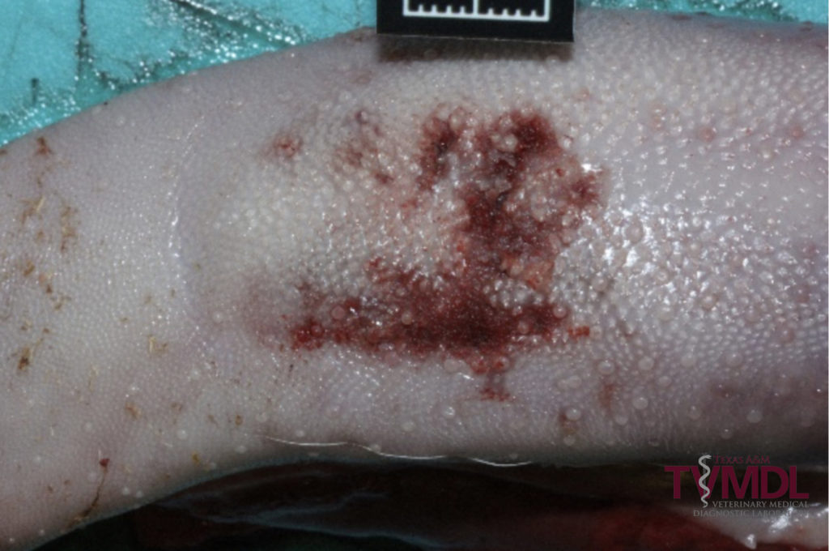
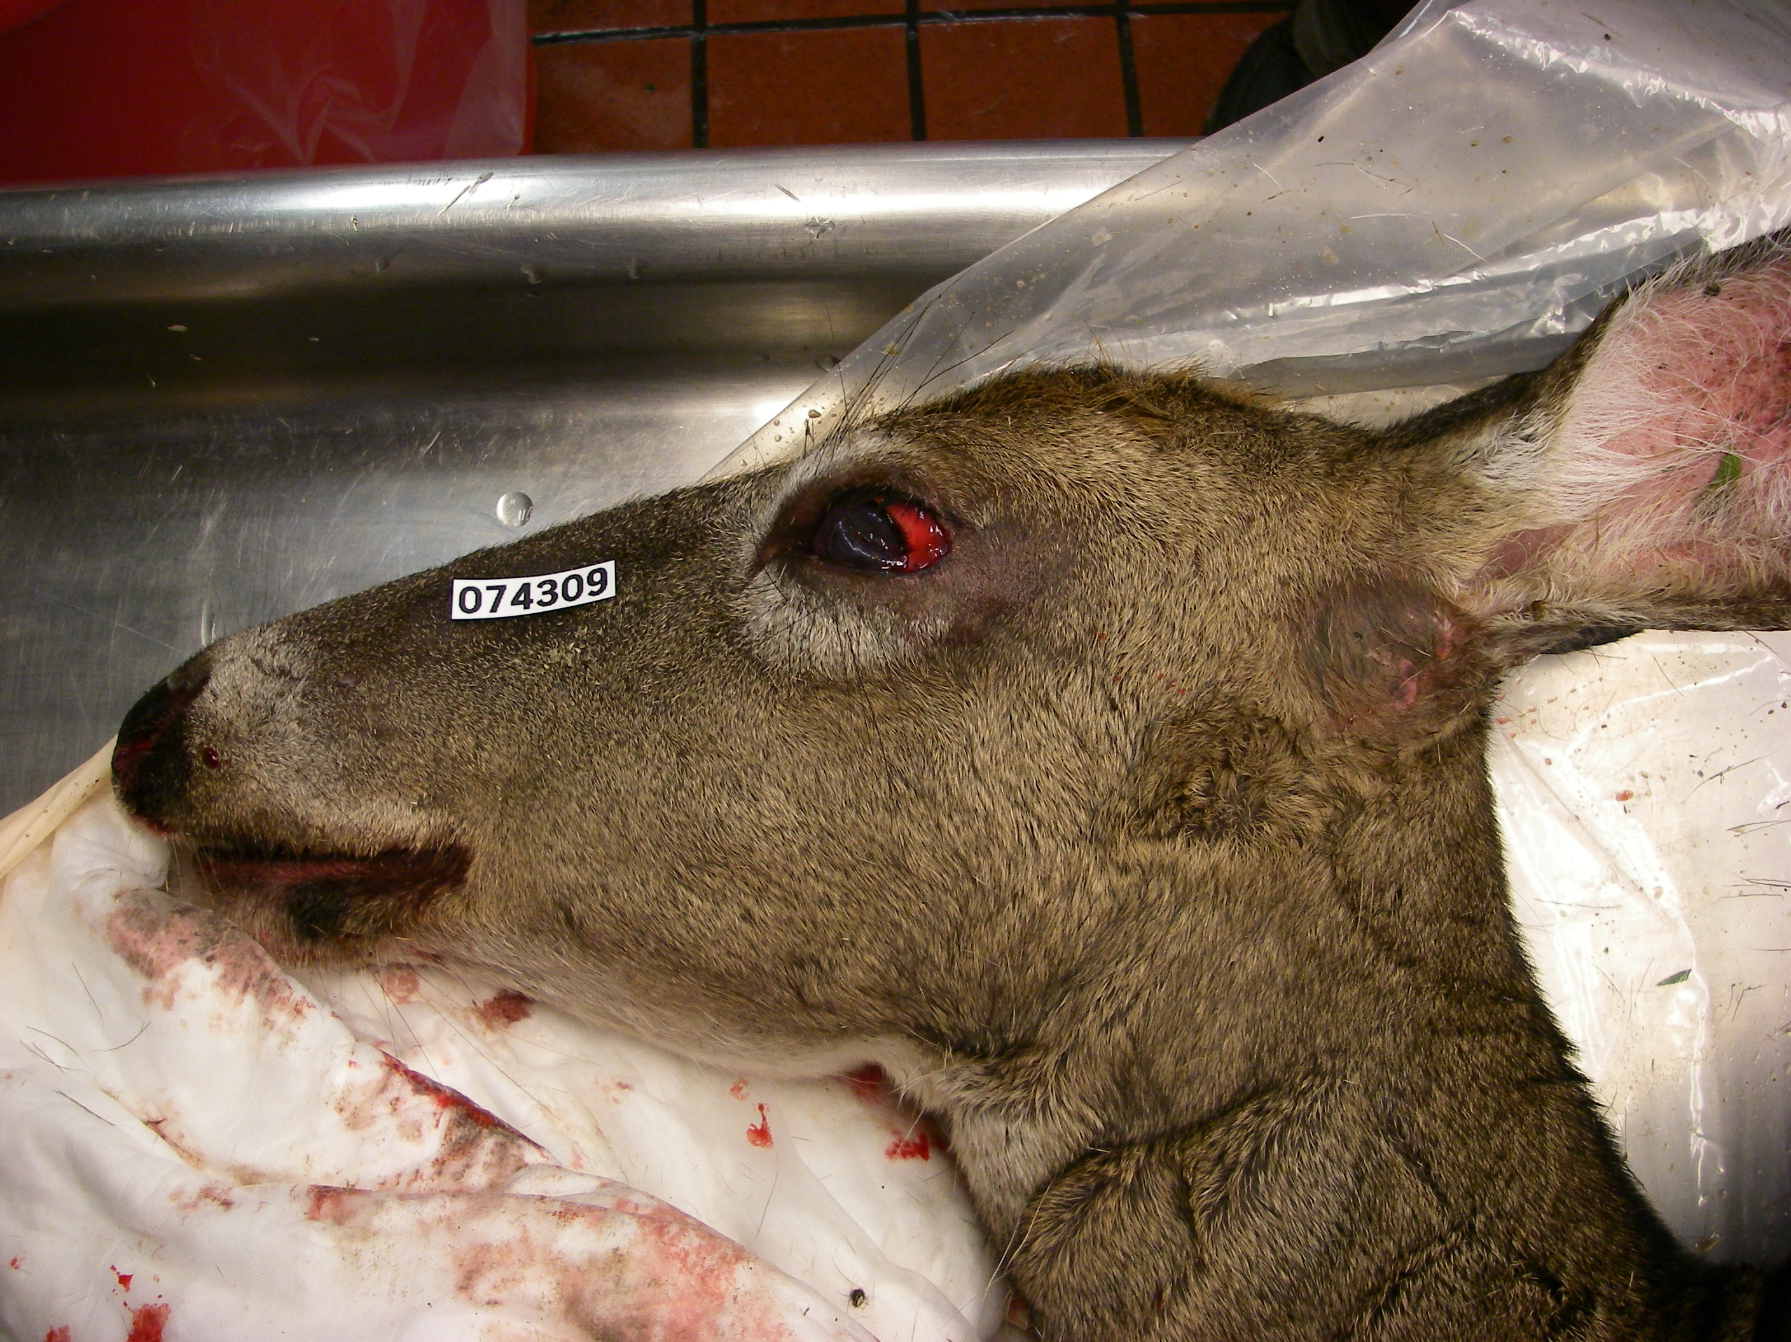
Acute
High fatality rate
Common in northern USA
Can last several weeks and may result in chronic form of disease
Symptoms include:
Hemorrhaging throughout body tissues
Ulcers throughout upper gastrointestinal tract
Interrupted hoof growth and lesions
Severe congestion
Necrosis
Edema in head, neck, limbs
Notes:
Edema of the eye, and ulceration of the tongue

Slide 9
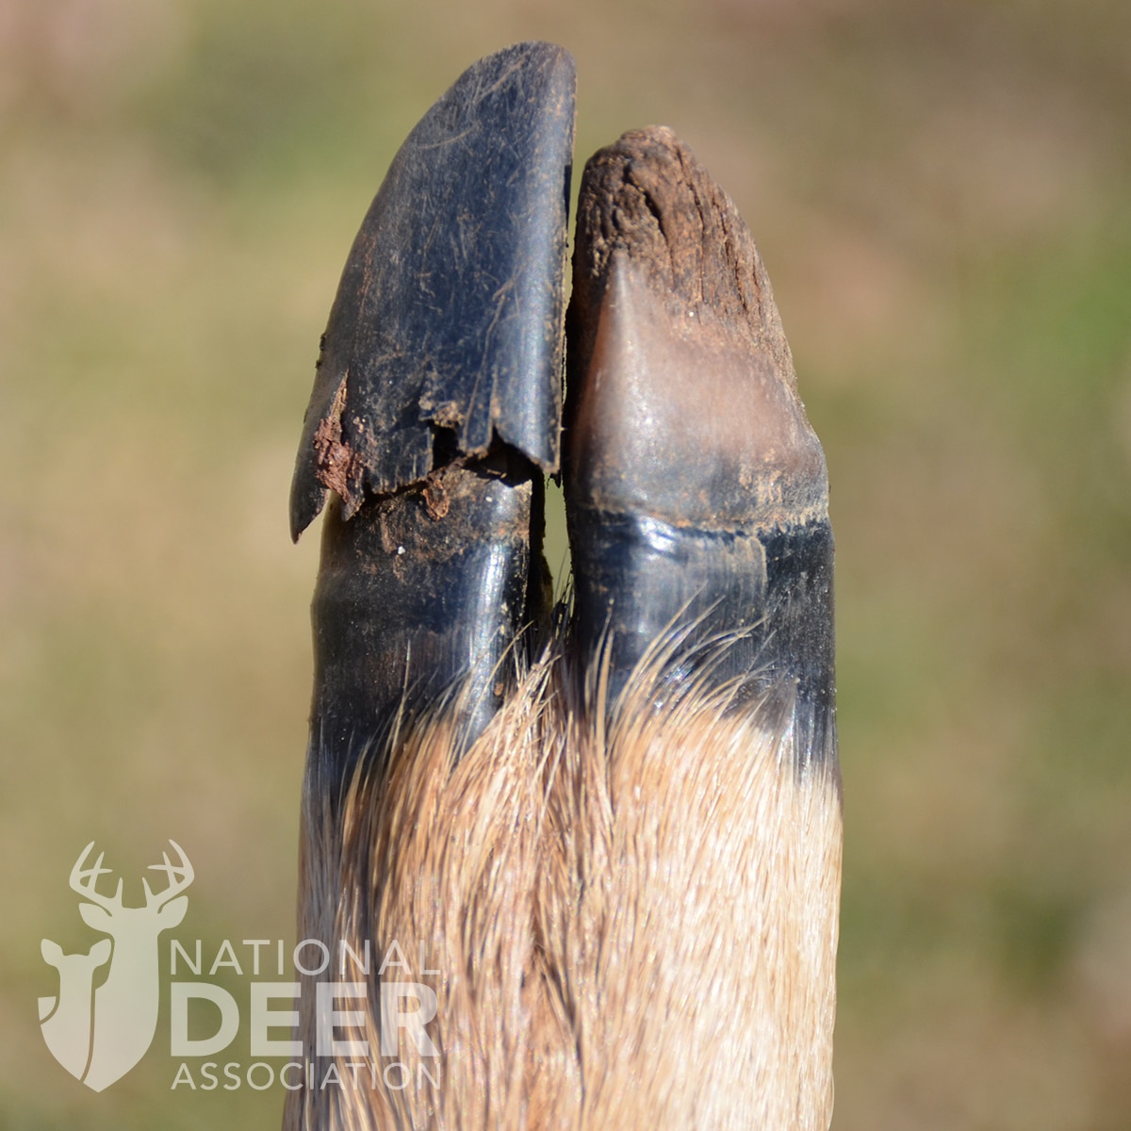
Chronic
Low fatality rate
Hoof lesions and lameness
Rumen scarring
Malnutrition
Common in Southeast
Notes:
Hoof sloughing leads to lameness and knee-walking

Slide 10
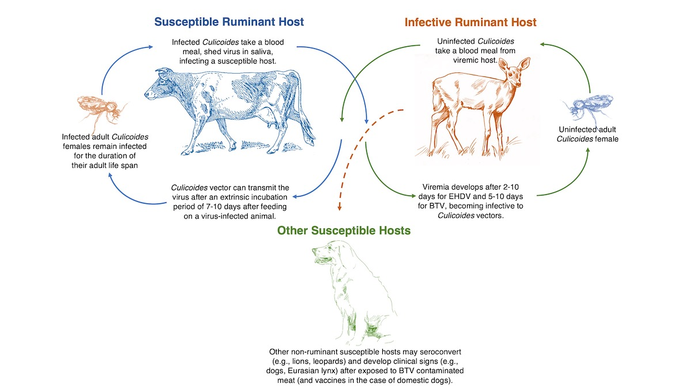

Slide 11
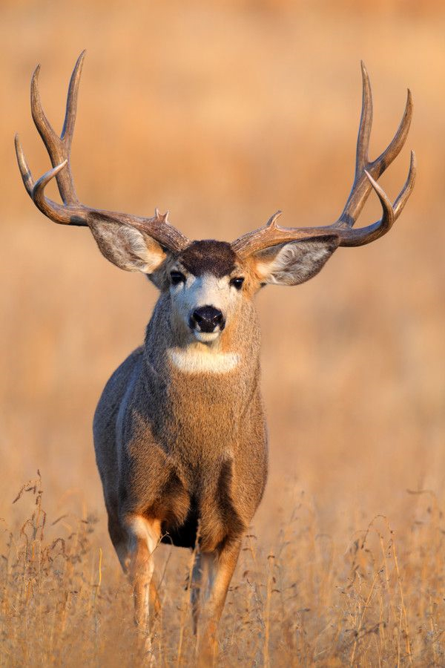
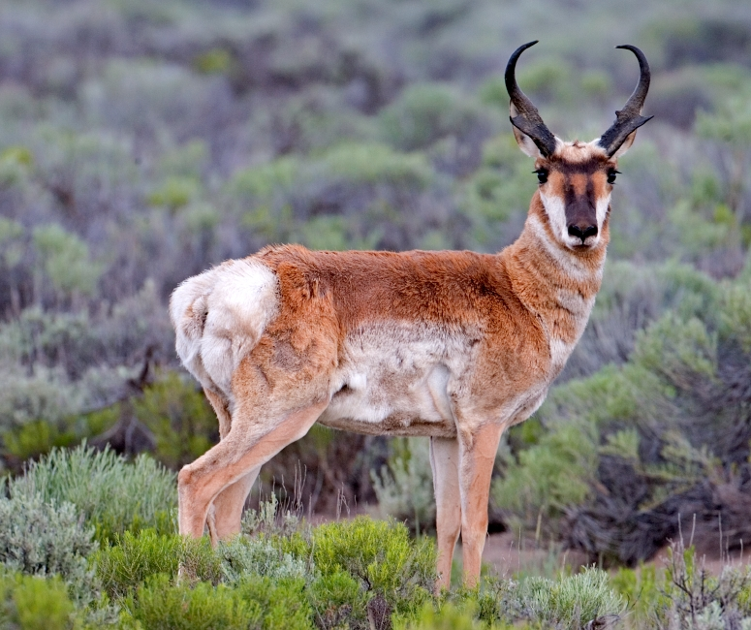
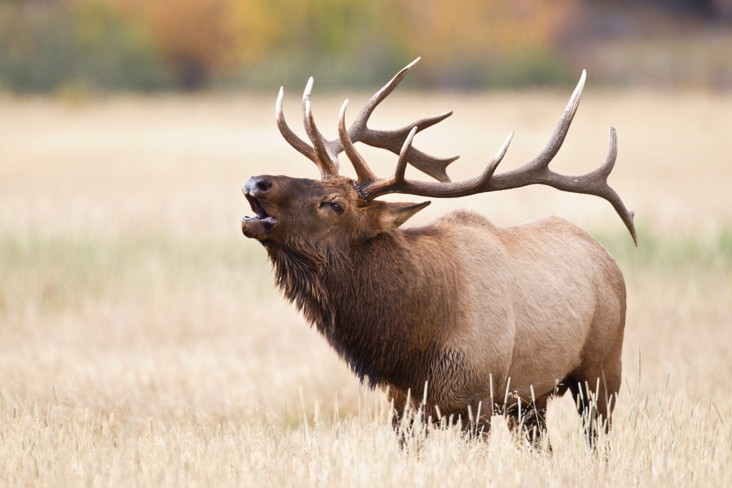
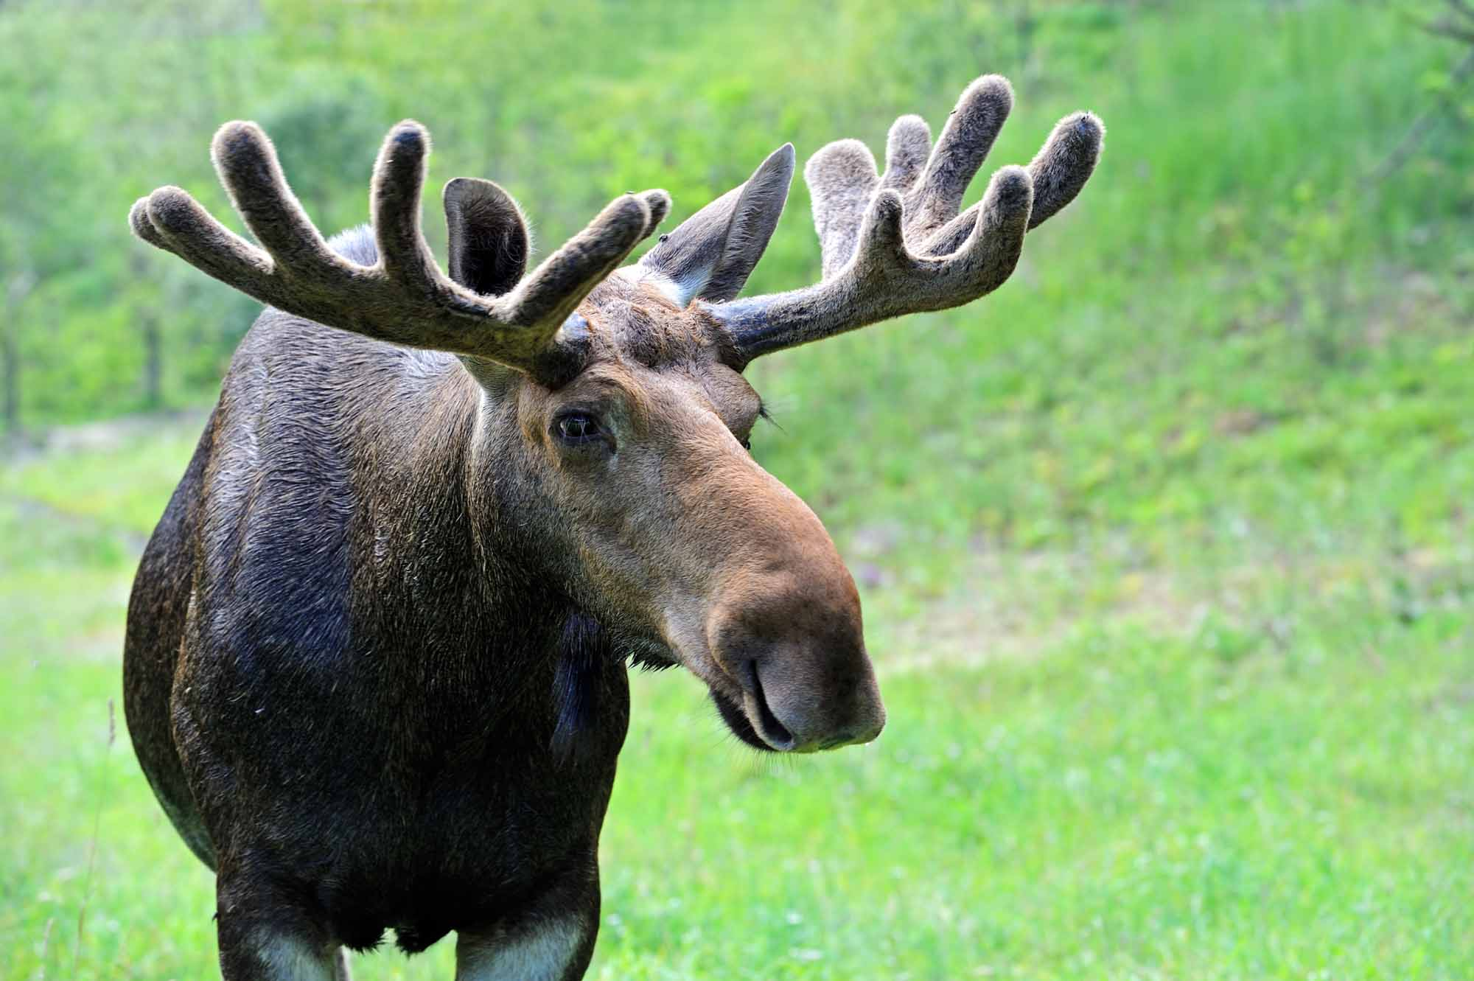
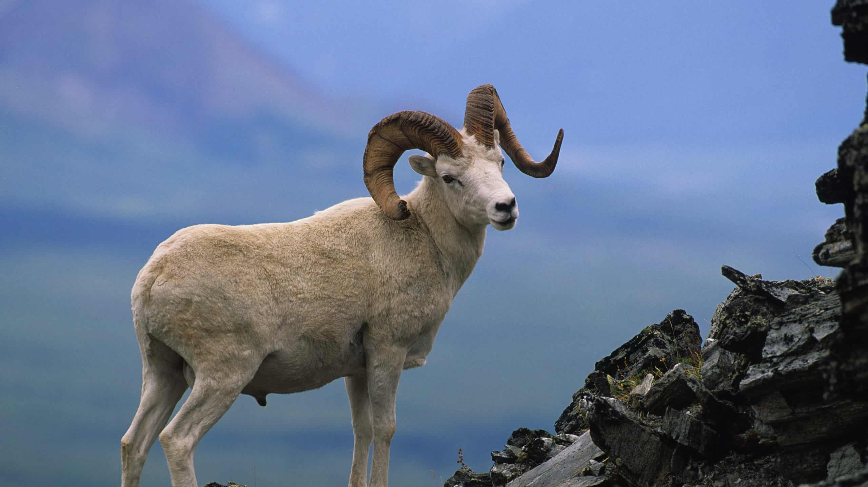
EHD in other wild ruminate hosts
Wild ruminates:
Mortalities documented for mule deer and pronghorn antelope
Infected elk develop mild symptoms
Antibodies to EHDV detected in moose and Dall sheep
Lower overall mortality and morbidity

Slide 12
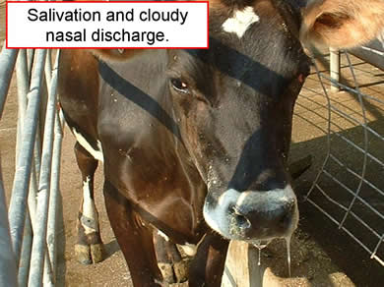
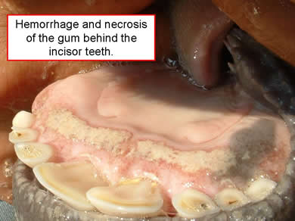
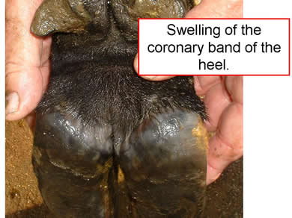
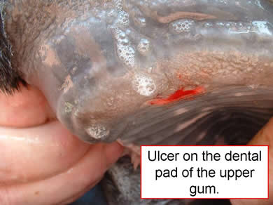
EHD in domesticated hosts
Domestic ruminants:
Cattle most common (outside of captive deer)
Swelling, ulcers, salivation, discharge, hemorrhaging, fever, hoof-sloughing, undernutrition
Most cases are subclinical unlike BTV
Less severe or asymptomatic compared with cervids
Notes:
EHD can affect livestock, particularly cattle however it is less severe than in cervids and typically asymptomatic outside of already weakened individuals. Symptoms shown here

Slide 13
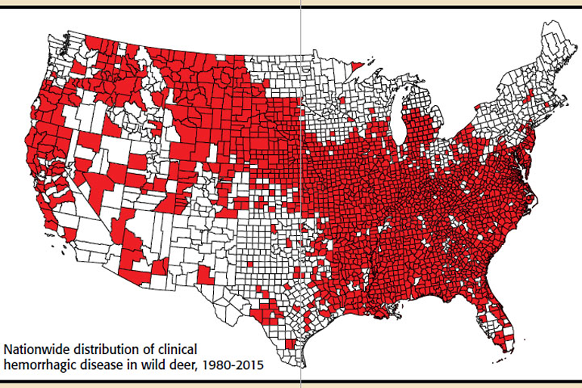
Notes:
Includes BTV

Slide 14
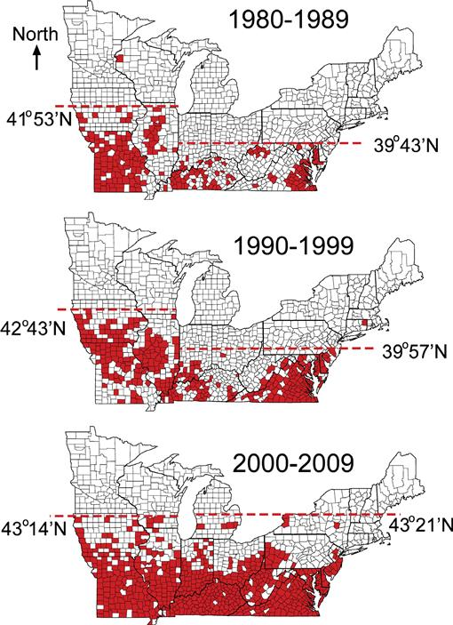
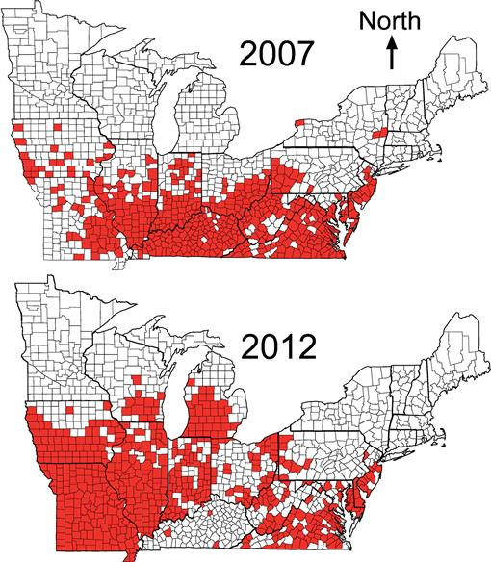
Stallknecht et al. (2015)
Notes:
Range expansion of confirmed EHD in WTD

Slide 15
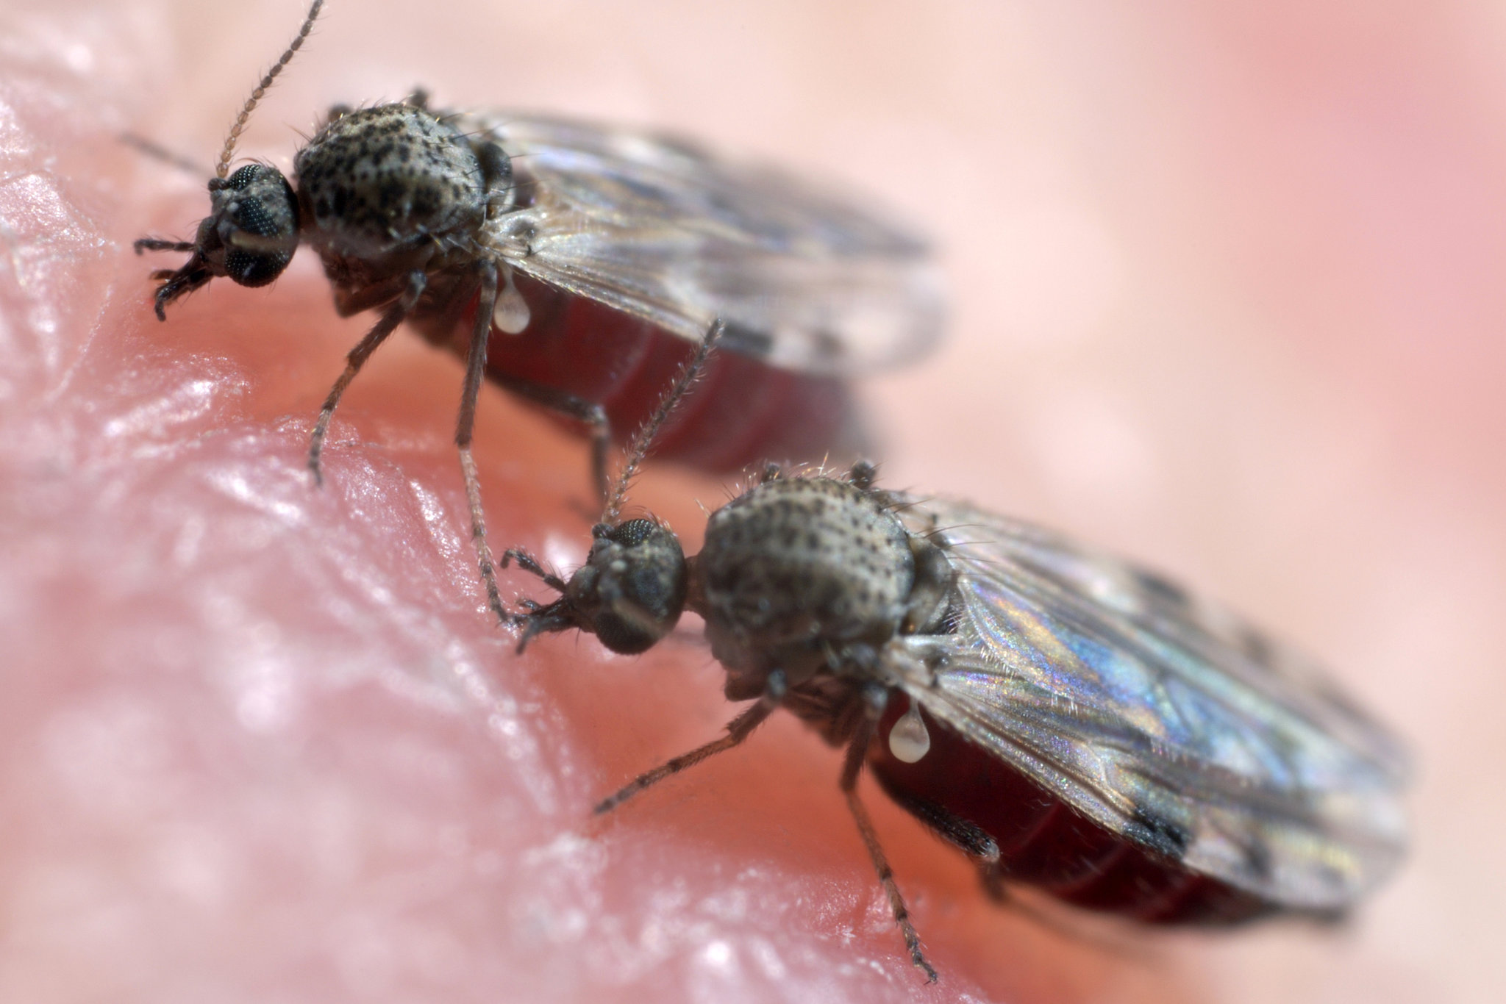
Environmental/Regional factors affecting EHD
EHD in northern USA: recurring seasonally, high mortality, variable
Mortality rates can be as high as 90% during some outbreaks
Some areas have outbreaks every 3-5 years during drought
Late summer and early fall
EHD in the Southeast: chronic infection, low mortality, mild cases
Nearly 100% of population have antibodies in some cases
Factors to consider:
Distribution and seasonality of midges, climate change
Herd immunity, previous exposure, genetics
Droughts, temperature, stream flow, wetland cover
Notes:
Die-offs can happen to both(?) but typically is result of other extreme conditions, drought

Slide 16
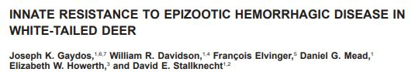
Regional Differences (Innate Resistance)
Innate Resistance (Gaydos et al. 2003)
Fawns of two subspecies of white-tailed deer infected with EHD
Northern subspecies (O. virginianus borealis) from area without EHD
Southern subspecies (O. virginianus texanus) from area with EHD
Infections in northern subspecies caused severe disease and mortality
Infections in southern subspecies caused mild or nondetectable disease
Notes:
Older paper comparing separate subspecies of deer using fawns. EHD infections in northern subspecies were severe and fatal while in southern species that occurs in area known for EHD viruses had mild or nondetectable cases of the disease in infected fawns.

Slide 17
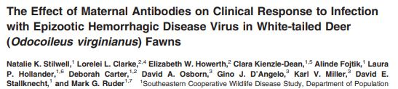
Maternal Antibodies
Maternal Antibodies (Stilwell et al. 2021)
Maternal antibodies against EHDV detectable in fawns up to 18 weeks
Captive does screened for antibodies to EHDV-2 in Georgia (65% positive)
Five maternal antibody-positive and five negative does chosen and bred
Fawns tested for maternal antibodies before experimental infection of EHDV2
All seronegative fawns exhibited mild to moderate clinical signs of HD
Seropositive fawns showed minimal clinical evidence of disease
Notes:
Southern deer throughout. Maternal antibodies detected and immune strength tested. Fawns experimentally infected with EHDV2. Detectable maternal antibodies provide protection against clinical disease and reduce viremia.

Slide 18
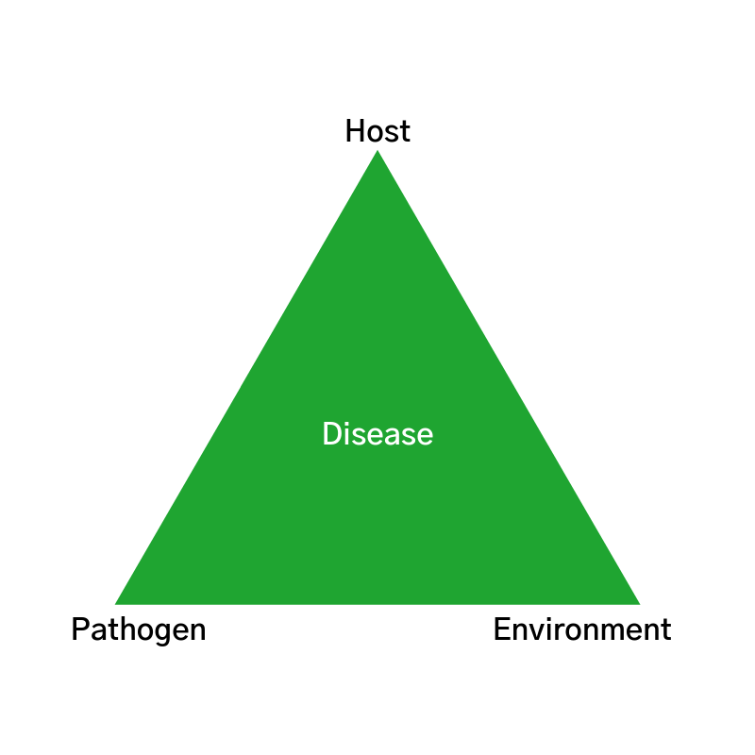
Disease Triangle of EHD (activity)
Notes:
Host-pathogen interaction: midge (vector) is infected by virus for life by consuming infected blood and then transmits infection to new host.
- This can be furthered with multiple species of hosts some of whom are asymptomatic but infectious, harboring the disease unlike dead deer.
Vector is affected by droughts, water availability, stream currents, climate change, frost, etc
- Midges require warm, wet environments. Eggs are laid in water, mud, or another saturated environment and the semi-aquatic larval stage occurs under the mud or another moist environment like swamps, marshes, and stream shores. When droughts occur and expose the mud or when the environment first becomes 10.9C and then sustains temperatures above -0.3C for a week, the adult midges emerge. Cycle can occur in two to six weeks or longer depending on environment.

Slide 19
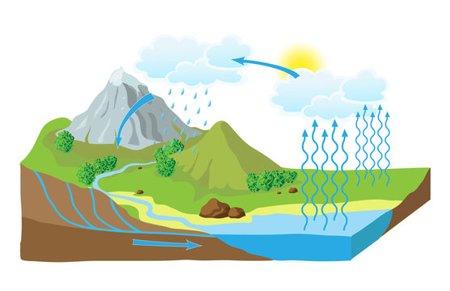
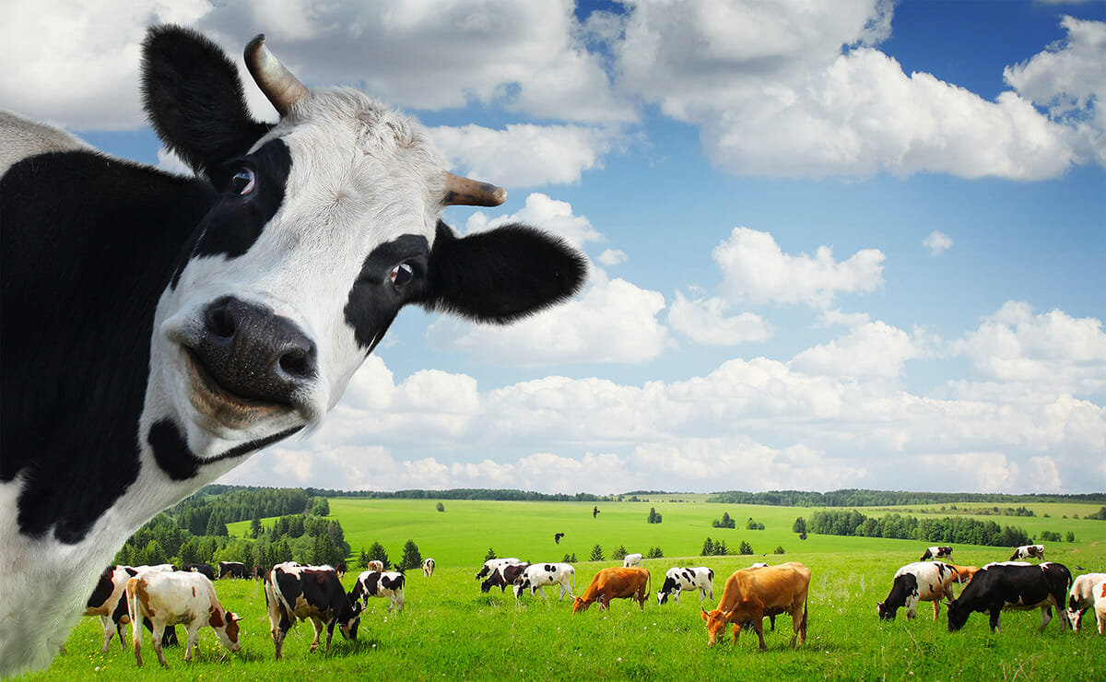
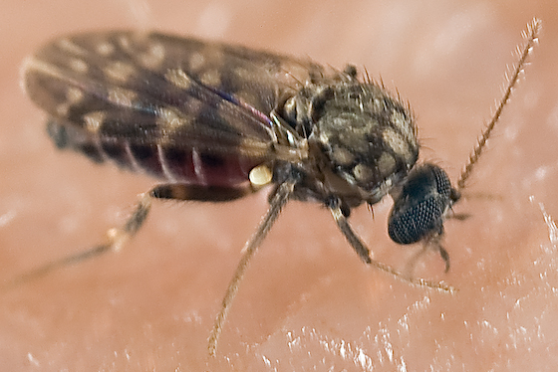
Disease Triangle of EHD (activity)
Environment
Livestock-Wildlife Interface
Seasonality, Climate
Host
Pathogen
Vector
Notes:
Host-pathogen interaction: midge (vector) is infected by virus for life by consuming infected blood and then transmits infection to new host.
- This can be furthered with multiple species of hosts some of whom are asymptomatic but infectious, harboring the disease unlike dead deer.
Vector is affected by droughts, water availability, stream currents, climate change, frost, etc
- Midges require warm, wet environments. Eggs are laid in water, mud, or another saturated environment and the semi-aquatic larval stage occurs under the mud or another moist environment like swamps, marshes, and stream shores. When droughts occur and expose the mud or when the environment first becomes 10.9C and then sustains temperatures above -0.3C for a week, the adult midges emerge. Cycle can occur in two to six weeks or longer depending on environment.

Slide 20
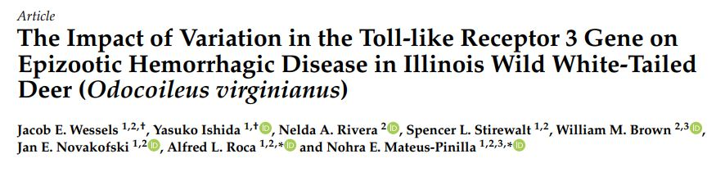
Current Issues and Ongoing Work
Genetics (Wessels et al. 2023)
EHD virus is a double-stranded RNA (dsRNA) virus
TLR3 gene sequenced (immune response to dsRNA viruses)
Two single-nucleotide polymorphisms (SNP) had significant difference in frequency between EHD-positive and EHD-negative deer
Notes:
EHD continues to impact animals across the country with mass die-offs continuing to occur up north. Climate change may expand the range of the midges exposing low-immunity herds. Harvest regulations may need to be altered after outbreaks.
Disease control more viable than eradication. Vector control in peak season, vaccination (none commercially available), harvest management

Slide 21
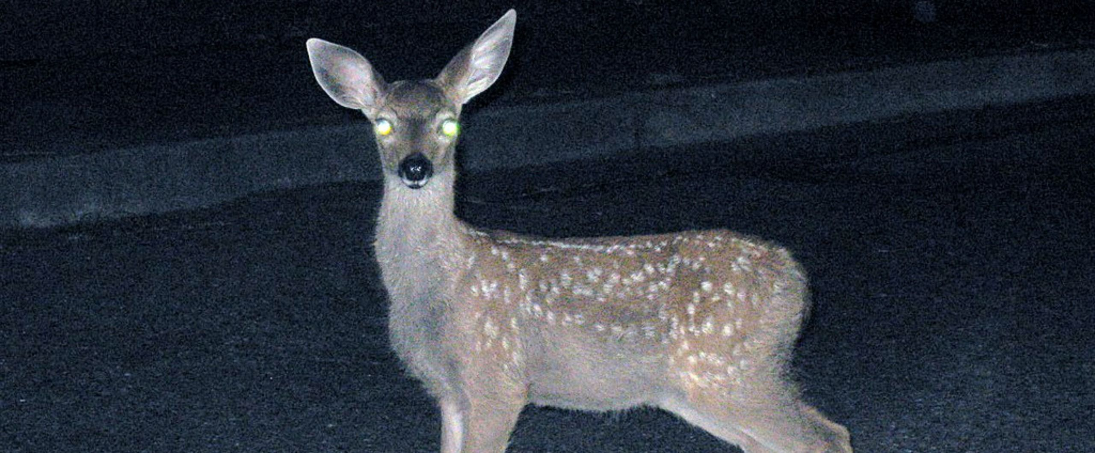
Questions?

